Slide 1
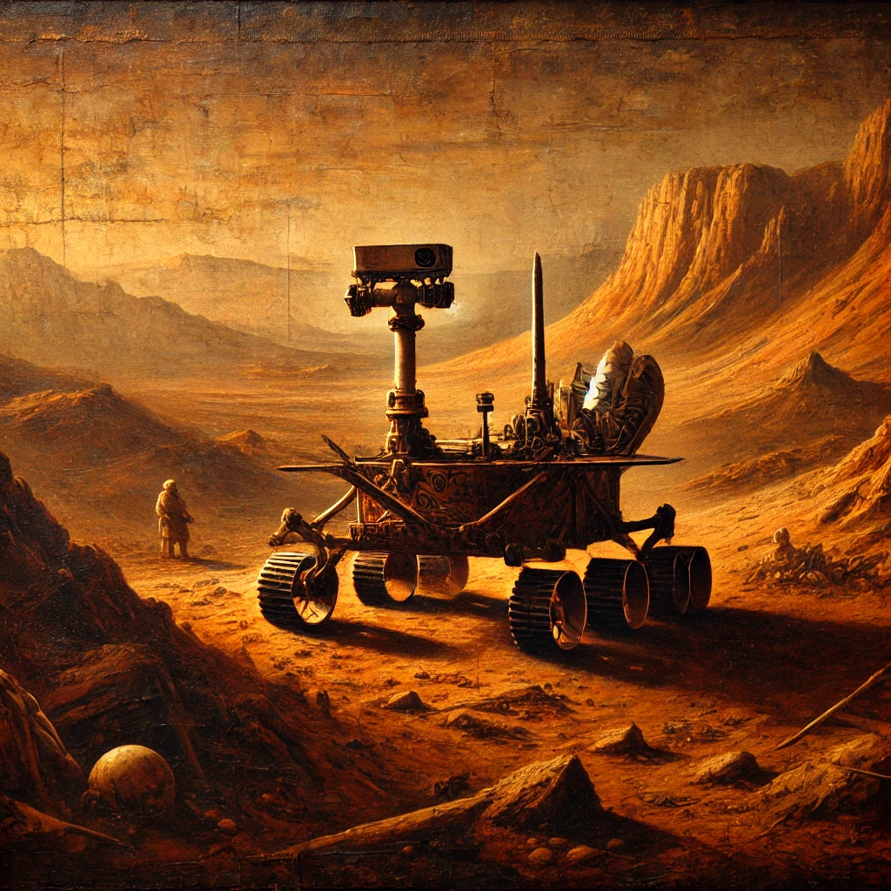
Simple stupid Robot
In making by Thomas, Robbe, Adam

Slide 2
The vision of mars rover
power efficient to last long on harvested energy
low power communication , BLE for inter robot communication and LoRa to send out some sensor readings to be monitored on a dashboard
temperature sensor for the environment temperature as wel as an Gyroscope to detect any anomalies when standing still or driving the rover
- Lastly, energy awareness is an important key stone of our system as it relies on harvested energy.

Slide 3
MVP
The MVP (Minimal Vital Product) contains the following items:
- LoRa module connection that transmits data.
- Dashboard to review received data.
- The ability to measure temperature and humidity.
- Only measure when there is enough energy available.

Slide 4
S.S.R.
As humanities interest in Mars grows, an understanding of its weather is needed. One of the greatest challenges that the planet provides are the frequent dust storms.
This project will try to monitor the weather phenomenon (such as temperature, humidity, light, ...) to predict such storms.
(so good! I think we can say that !!!)

Slide 5
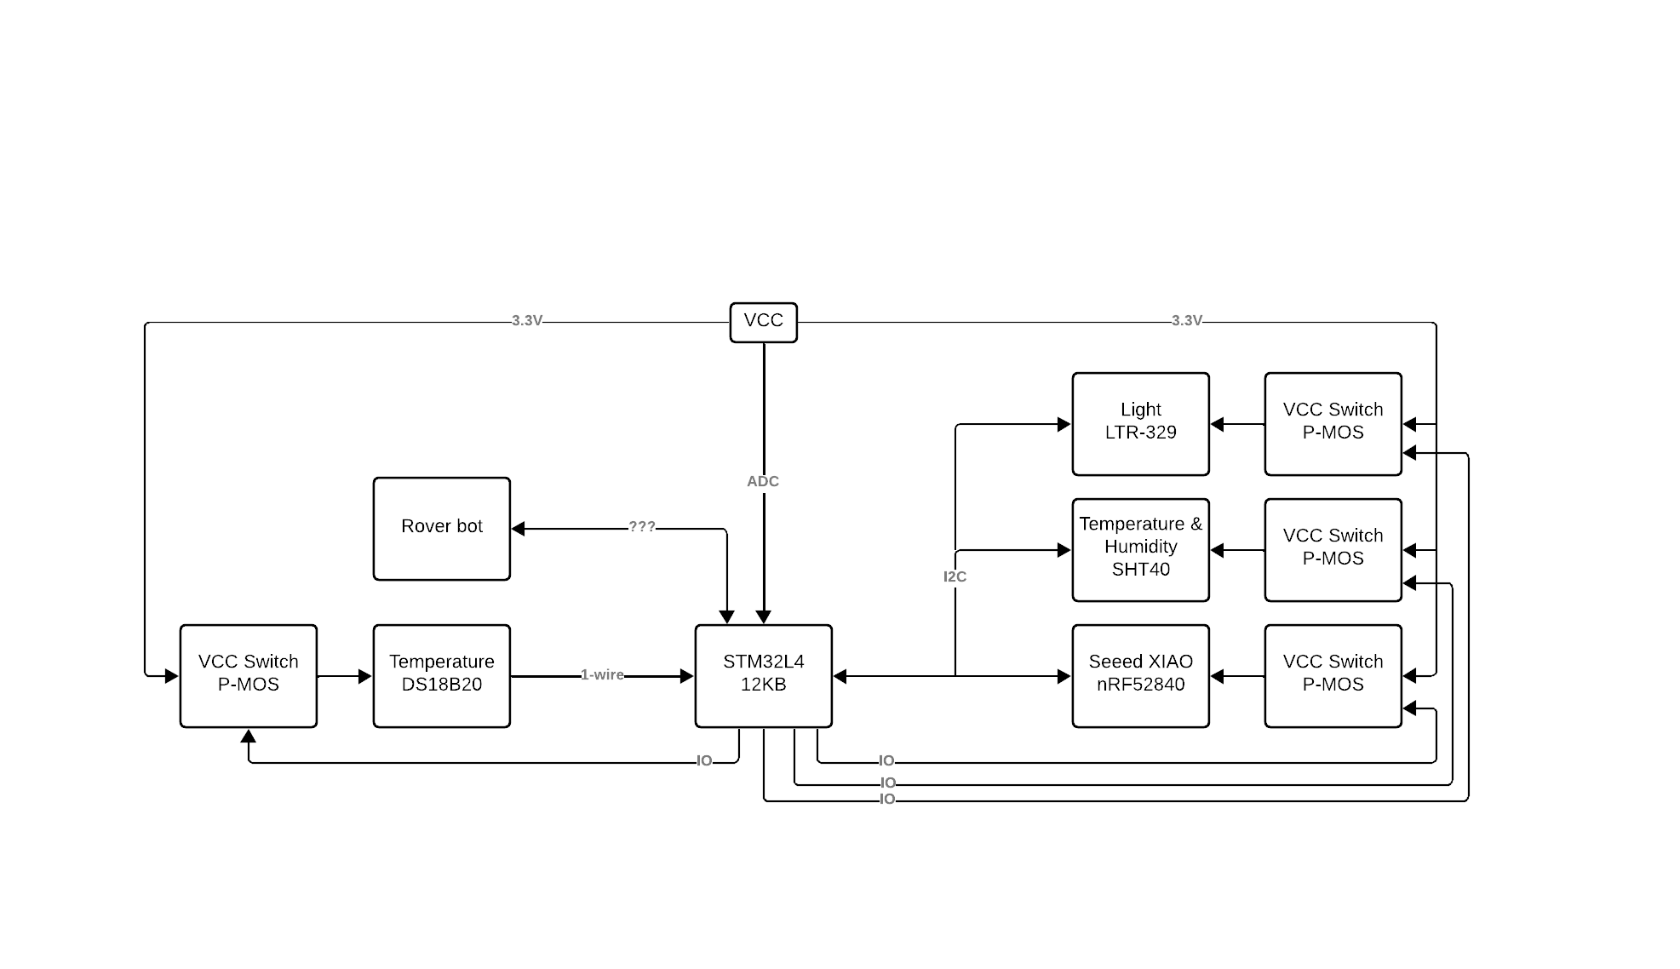
As can be observed from the block diagram there is need for:
- four IO's,
- one ADC,
- one I2C interface,
- and one 1-Wire interface.
In total, these are 10-pins. This case is when we use the L412 as the brain and SEEED XIAO as a BLE module….
When nRF52840 is the brain, 10 pins are needed.

Slide 6
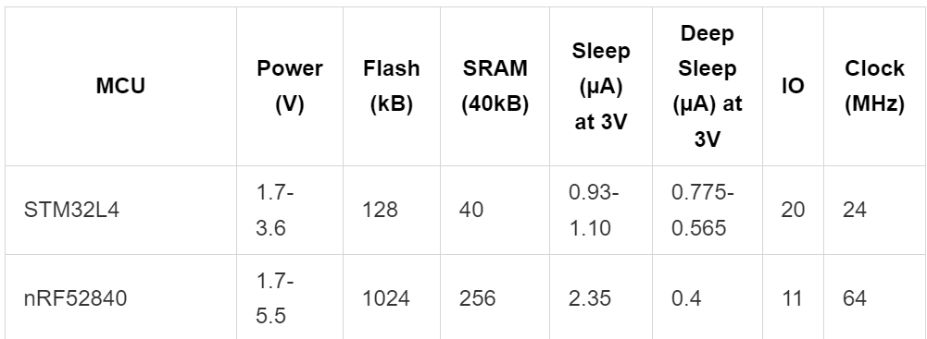
STM32L4 VS nRF52840
In order to select which MCU is the brain, some comparison is required.

Slide 7
We could probably just say this
STM32: Sleep mode is supply current in stop mode 2 with RTC enabled & RAM retention (p. 99)
STM32: Deep Sleep is in Standby mode with RTC enabled & no RAM retention (p. 105).
nRF52840: Sleep mode RAM is retained and an internal clock/ interrupt is used (p. 56).
nRF52840: Deep Sleep mode RAM is NOT retained and external interrupt is needed (p. 56).
Conclusion: We continue with STM32L4 which has the ability to use the FLASH as EEPROM where this is not usable in nRF52840 (PROGMEN is read-only so not an option). With the usage of EEPROM, we can store the data before entering deep sleep and after the wake-up or reset it can fetch the data or add data to it if needed. This is not the case for nRF52840, although, it has better current consumption in Deep Sleep.

Slide 8
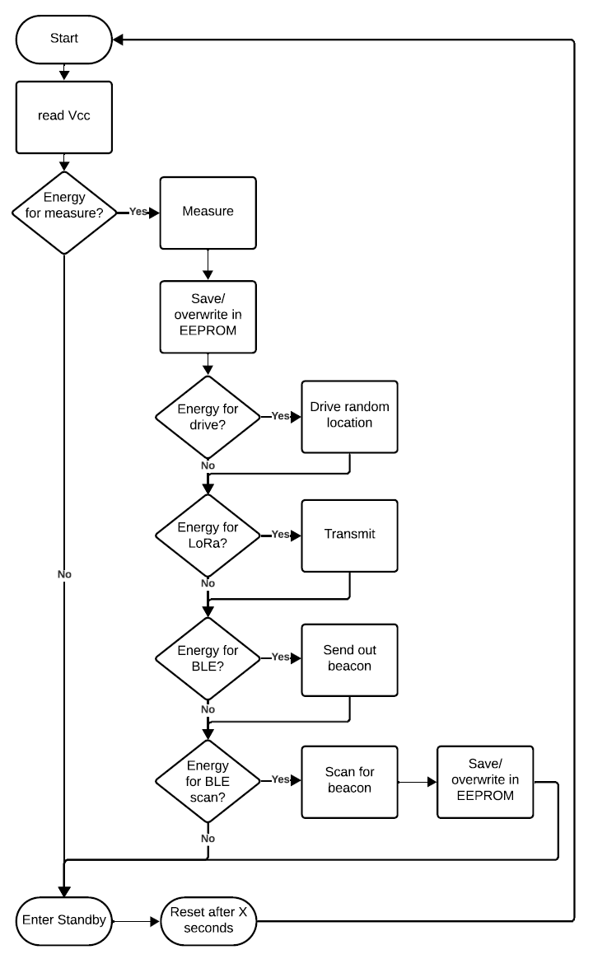
Our brain, STM32L412KB, will have a certain flow as depicted in the block schematic below.
This is coded in a finite state machine which cycles through the different states. This to provide a minimal code footprint onto the MCU.

Slide 9
Teamwork
Adam
enviromental sensing
Energy output managment
Robbe
BLE communication between bots
Energy managment
Thomas
Gyroscope
LoraWAN -> NoteRED server

Slide 10
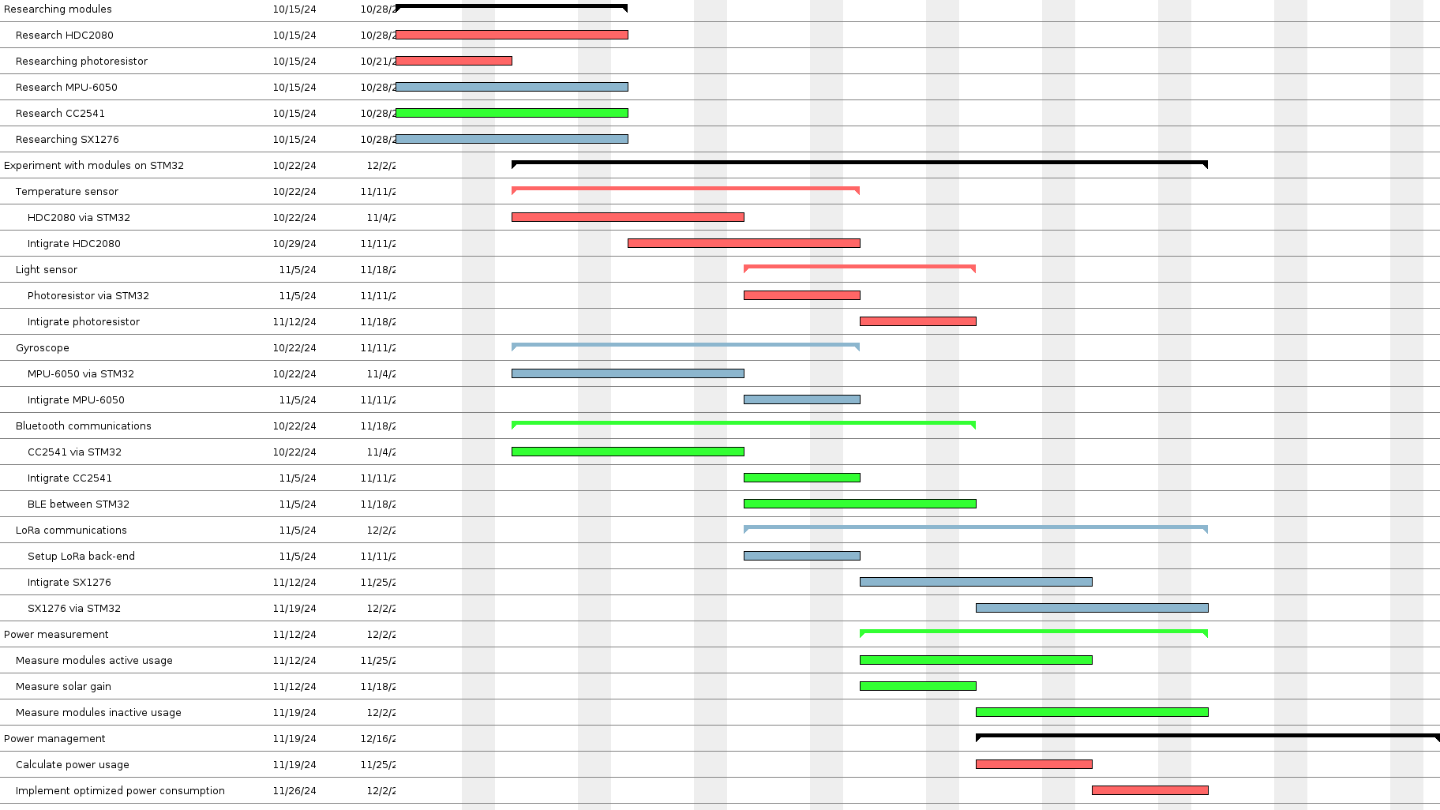
Gentt chart

Slide 11
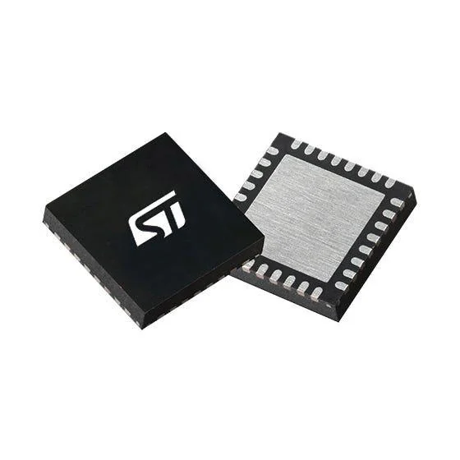
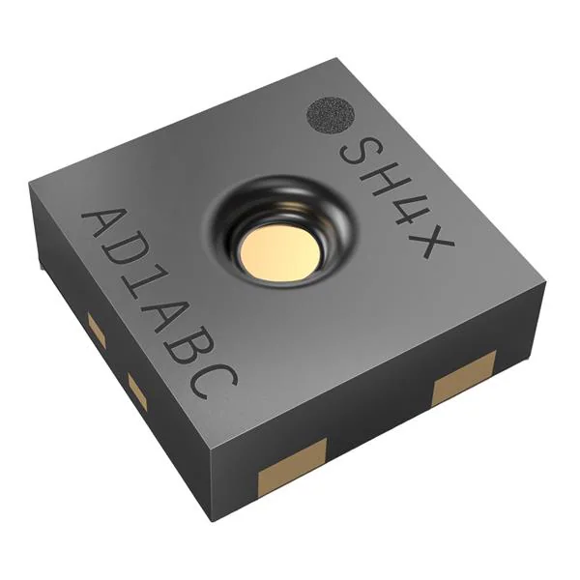
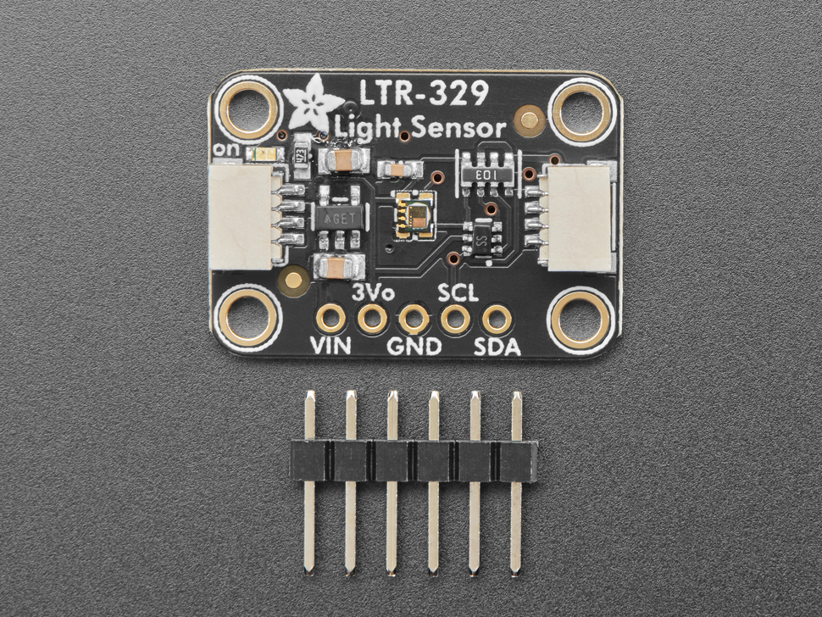
Sensing
asd

Slide 12
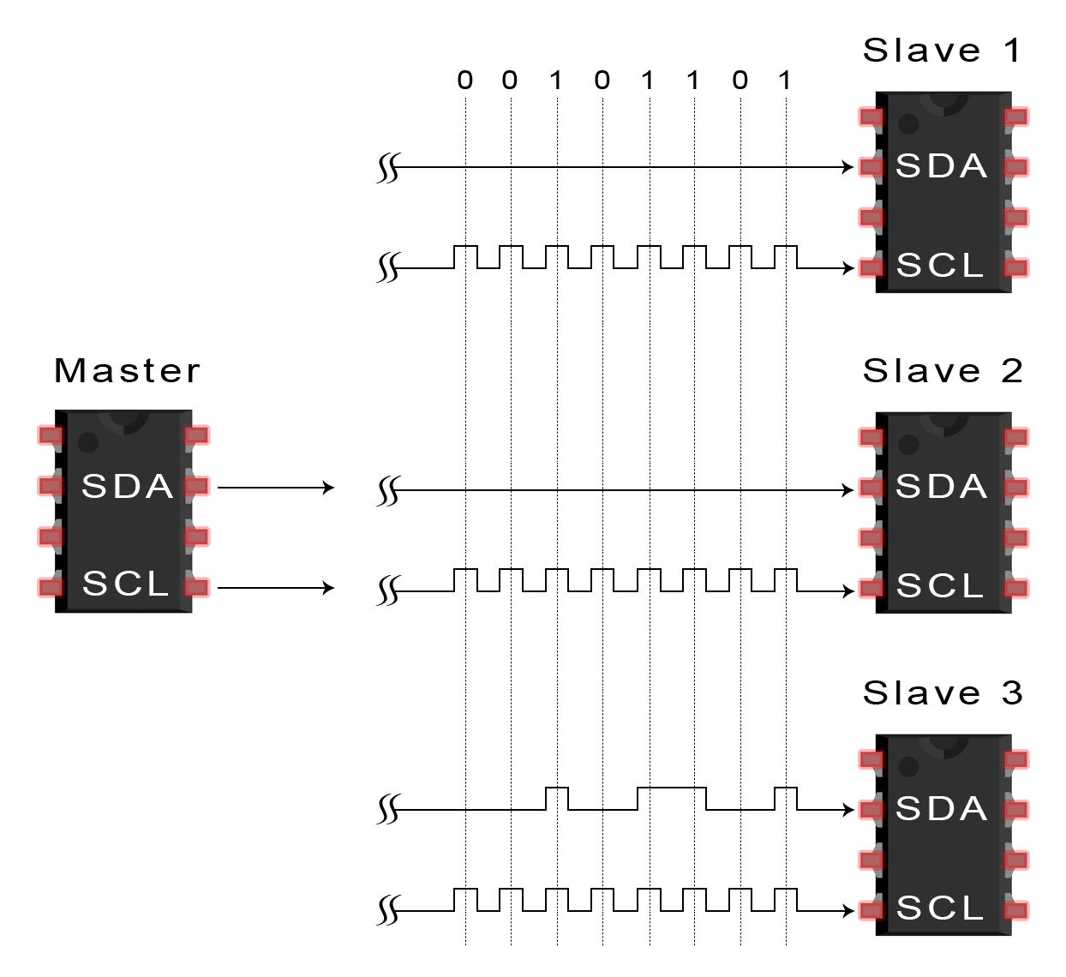
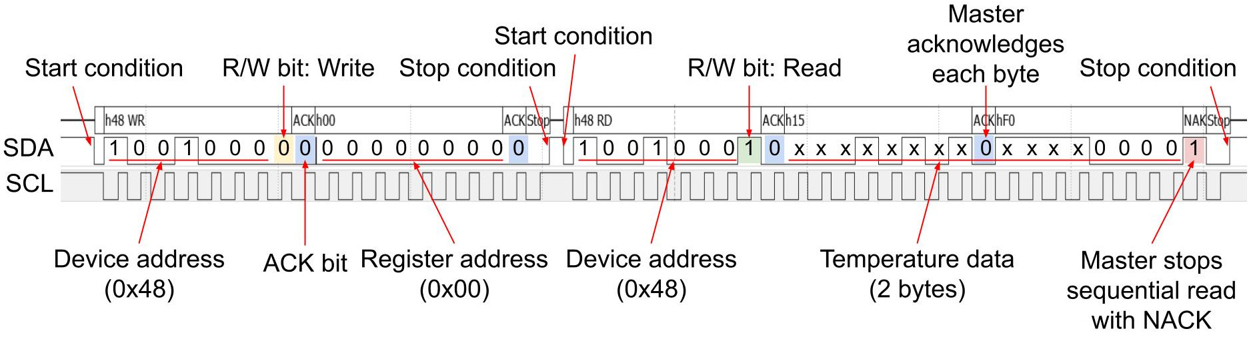
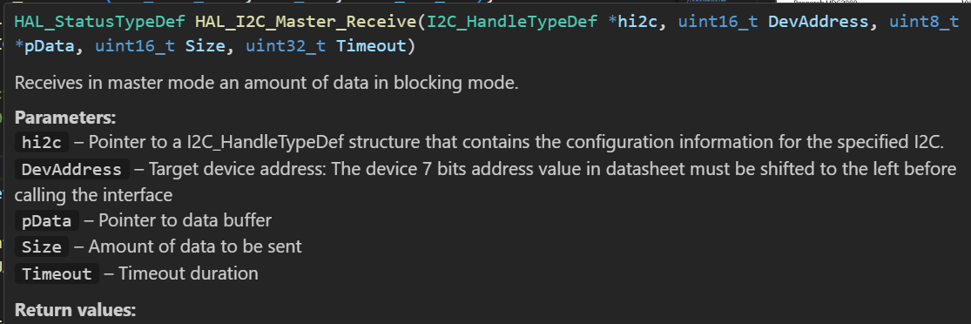
I2C
Overall i would probably just talk about the ideal way of sensing and how it should be done,
Then i would like mention that its my firs time doind I2C communication and then i could show my code that will hopefully whork by then.
I could also mention the photo resistor idea

Slide 13
Energy Measurements and managament
Joule scope measurements ?!
„This measurement is done to identify and verify that the datasheet is correct about the $0.775-0.565 µA$ in Deep Sleep.
The test code will have a counter that is increased every startup. This counter is saved in the virtual EEPROM. This counter states how many times a led must blink at startup,Thus, it is easly verified at which cycle the STM32L4 is in.
The Standby code will last for $33$ seconds when we use a prescaler of $/16$ at the Low power Oscillator of $\pm 32kHz$ and a compare value of $0xFFFF$ which yields in $\frac{16}{\pm32kHz} = 0.5ms$ and
$0.5ms \times 2^16 = 32.768 \Rightarrow \pm 33 seconds$.“

Slide 14
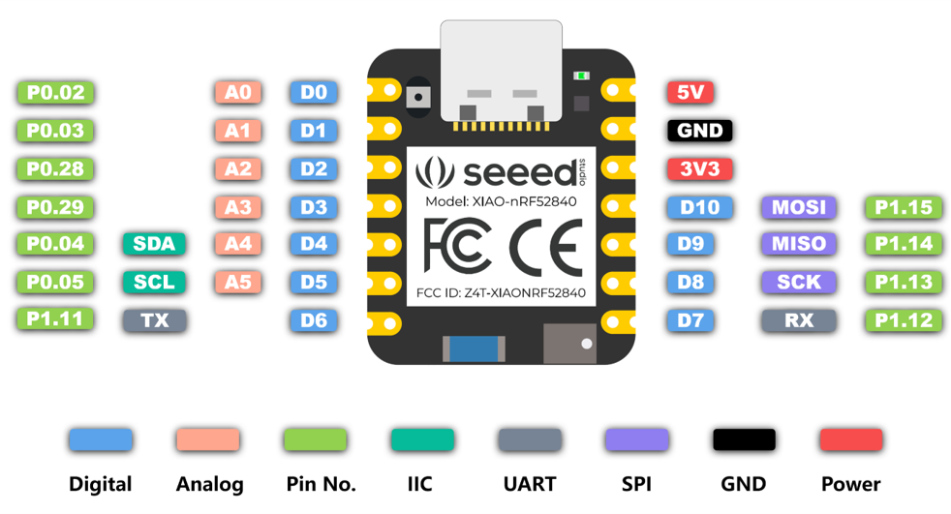
BLE comm

Slide 15
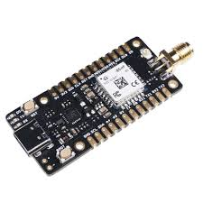



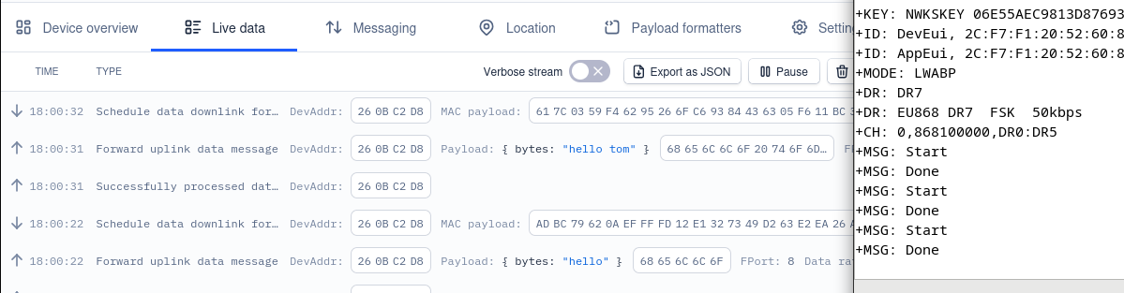
Lorawan ith moderated nodered server !!!
LoRaWAN
MQTT

Slide 16

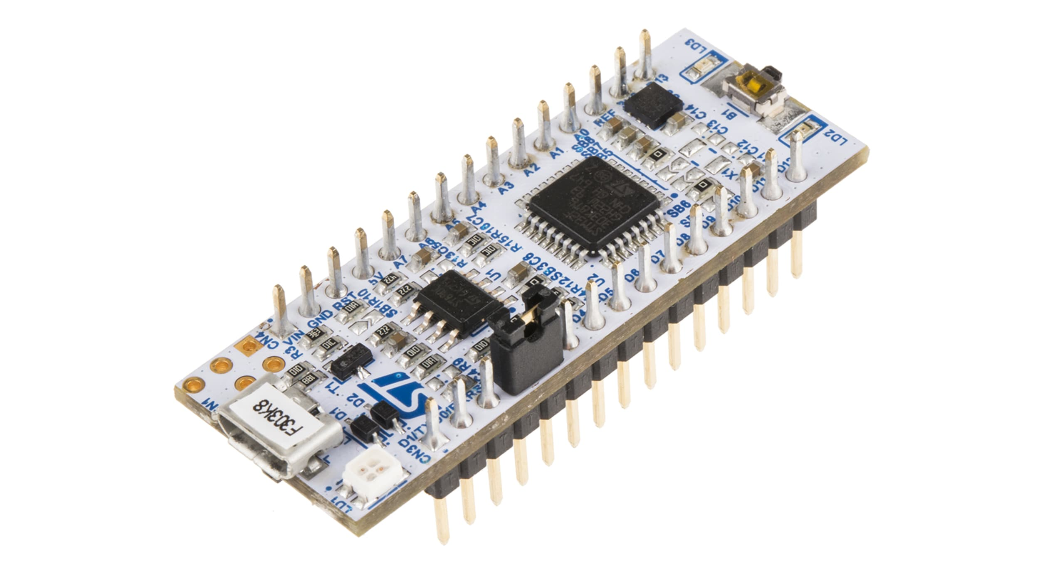
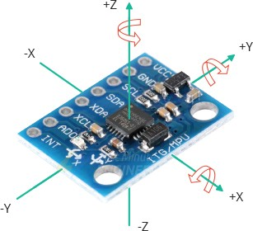
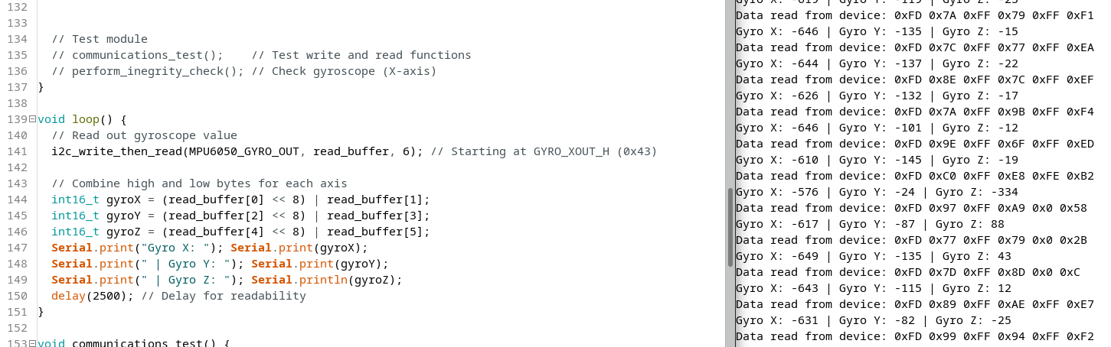
Gyroscope IMU
I2C

Slide 17
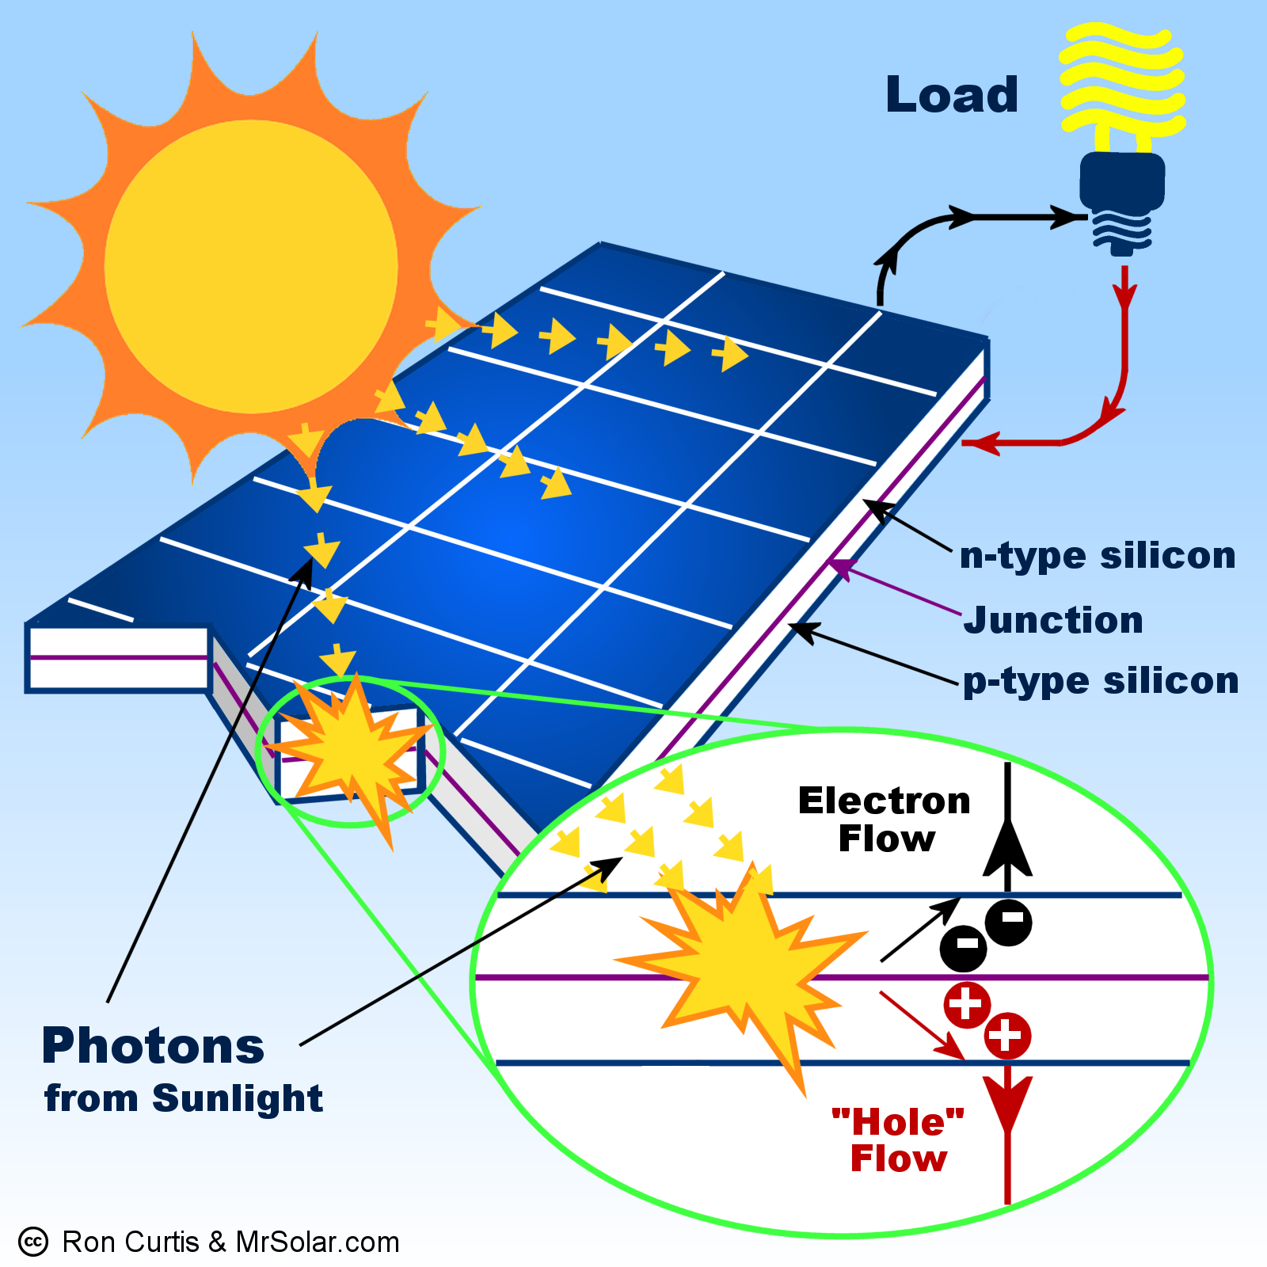
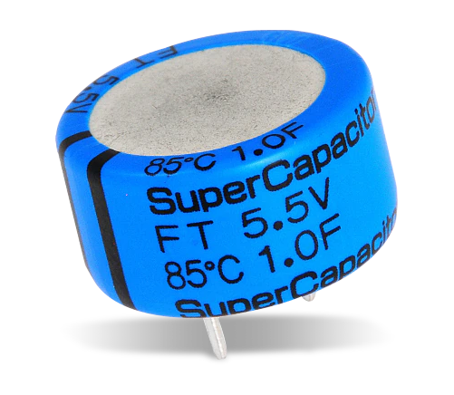

Enegry output managmenT

